Slide 1
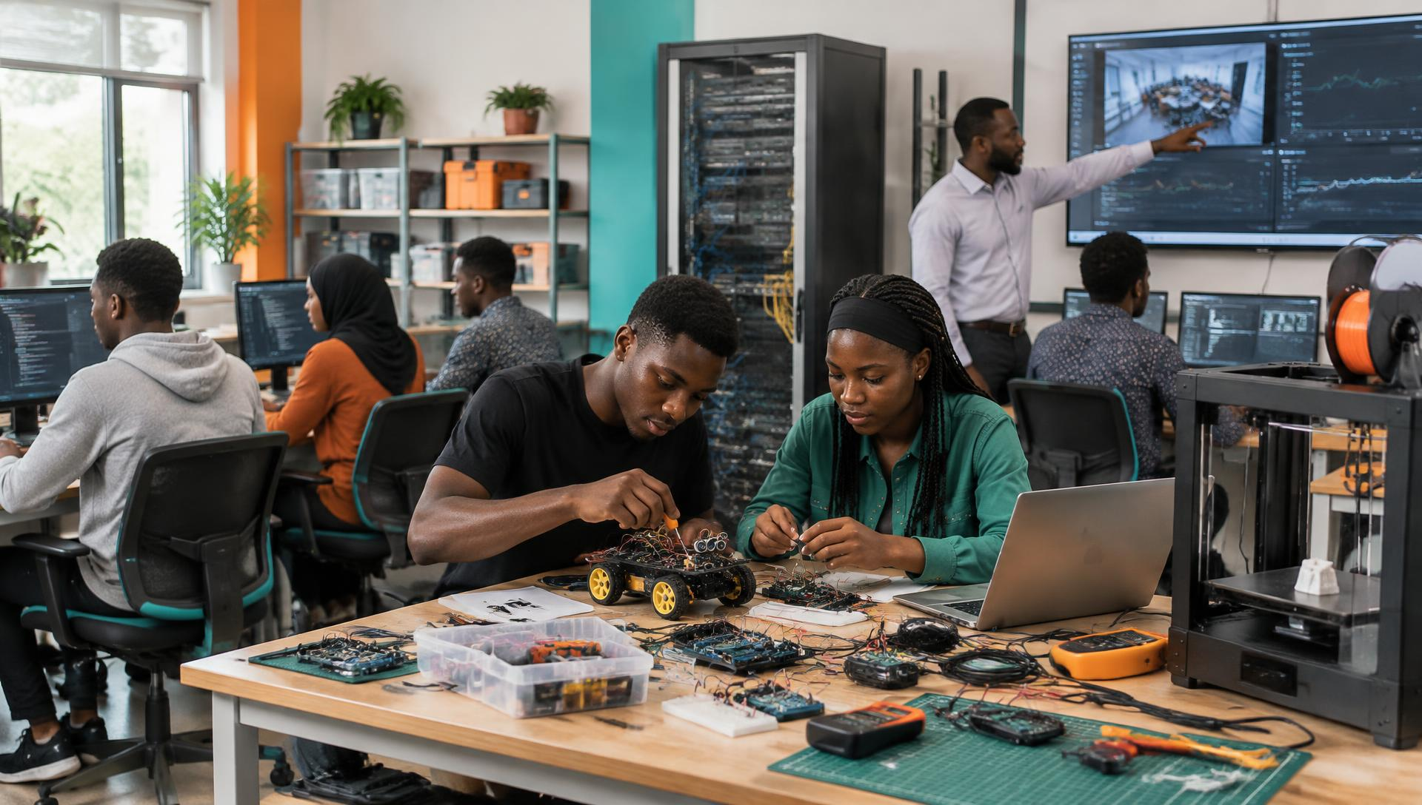
PROPOSED PARTNERSHIP · NIGERIA
Practical Technology
Partnership
Computers, robotics, electronics, AI, networking, 3D printing and reliable power—sourced, delivered and supported.
Smart Technology. Smart People.
TEKLOFTS × SQI COLLEGE OF ICT
Notes:
Open by defining the partnership in plain language: Teklofts proposes to source, deliver, install and support the physical equipment SQI chooses. Emphasise that this is a practical, phased proposal—not a large project commitment.

Slide 2
WHO WE ARE
Useful technology, made easier to access and use.
01
02
Computers & accessories
AI, IoT & robotics equipment
OUR MISSION
The right equipment and support—without unnecessary complexity.
03
04
Solar, inverter & backup power
Networking & connectivity
05
06
If an item is not in our catalogue, we can source it to SQI’s specification and budget.
International product sourcing
Delivery, setup & basic support
Notes:
Explain Teklofts through tangible products and services. Our vision is to make useful technology easier to access and use. Our mission is to help schools, businesses and individuals get the right equipment and support without unnecessary complexity.

Slide 3
CUSTOMER TESTIMONY
What Teklofts customers say about our products.
VERIFIED CUSTOMER REVIEW
VERIFIED CUSTOMER REVIEW
VERIFIED CUSTOMER REVIEW
“The power bank is so durable, so powerful and portable. And very fast.”
“The sound is just perfect!!!”
“Everything looks and works exactly as shown. No BS, no exaggeration.”
Soma
Dennis Addai Tawiah
A.A.
66W Power Bank · Source: teklofts.com
Audio · Source: teklofts.com
General purchase · Source: teklofts.com
Notes:
Use these as Teklofts product-customer testimonials only. Do not imply that the reviewers are SQI clients or that these reviews prove institutional deployment experience. The wording is taken from the supplied Teklofts review presentation.

Slide 4
WHAT WE UNDERSTAND
SQI already teaches technology. Teklofts adds physical equipment and practical support.
Students
Technology courses
Teachers & instructors
THE PRACTICAL QUESTION
Practical learning
Campuses
Existing digital systems
AI & technology programmes
What equipment, products and support can Teklofts add?
We are not coming to replace what SQI already has.
Notes:
Acknowledge SQI’s students, instructors, campuses, courses, practical teaching, digital systems and AI programmes. Then state the boundary clearly: Teklofts is proposing to add physical equipment and practical support, not replace SQI’s systems or academic leadership.

Slide 5
COMPUTER EQUIPMENT
Computers and accessories, matched to SQI’s specification and budget.
PROBLEM
POSSIBLE IMPACT
TEKLOFTS PROVIDES
VALUE TO SQI
Students need suitable computers and accessories.
Missing or inconsistent equipment can limit practical sessions.
Specified computers, monitors and accessories.
Simpler procurement and access to required equipment.
Computers
Monitors
Keyboards & mice
Webcams
Headphones
Storage devices
Notes:
Ask SQI what computer specifications, quantities, software requirements and budget range it already uses. Teklofts can then source suitable products rather than recommending equipment before requirements are known.

Slide 6

ROBOTICS & ELECTRONICS
Components students can connect, programme, test and replace.
PROBLEM
POSSIBLE IMPACT
TEKLOFTS PROVIDES
VALUE TO SQI
Students need physical equipment to practise.
Theory may not become a working physical project.
Equipment kits and replacement components.
Students build, test and demonstrate working projects.
Robot kits
Arduino & ESP32
Sensors
Motors
Breadboards
Tools & power
Notes:
Name the equipment on screen: robot kits, Arduino and ESP32 boards, sensors, motors, breadboards, wires, tools and safe power supplies. Explain that replacement parts matter because practical components are consumed or damaged over time.

Slide 7
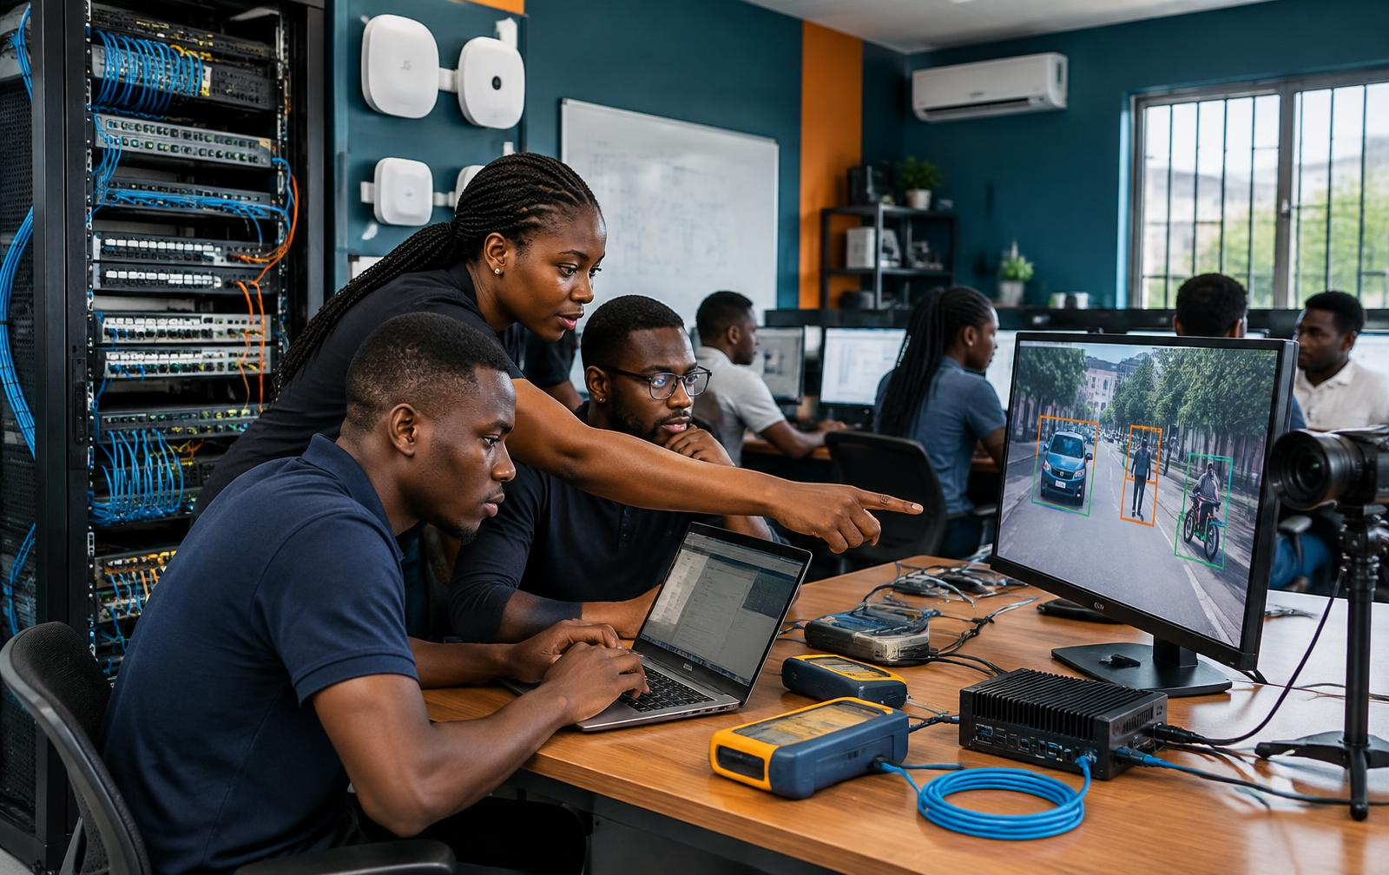
AI & COMPUTER VISION
Computers, cameras and edge devices for practical AI experiments.
PROBLEM
POSSIBLE IMPACT
TEKLOFTS PROVIDES
VALUE TO SQI
Students need equipment for hands-on AI experiments.
Fewer chances to test AI with physical devices.
Computers, cameras, edge devices and displays.
Students create detection, recognition and monitoring projects.
AI-capable PCs
Cameras
Edge devices
GPU equipment
Sensors
Displays
Notes:
Avoid saying only “AI solutions.” Explain that physical AI practice can require capable computers, cameras, small edge-computing devices, sensors and displays. Examples include object detection, image recognition and smart monitoring.

Slide 8
NETWORKS & CYBERSECURITY
Real network equipment for building, testing and securing connections.
PROBLEM
POSSIBLE IMPACT
TEKLOFTS PROVIDES
VALUE TO SQI
Students need equipment to set up and secure networks.
Practical networking skills stay limited without hardware.
Networking equipment and lab setup support.
Students build, test and secure real networks.
Routers
Switches
Access points
Network cables
Racks
Test equipment
Notes:
Point out the routers, switches, access points, cables, rack and test tools. Teklofts can supply equipment and help with the physical lab setup; SQI retains responsibility for teaching and curriculum.

Slide 9
3D PRINTING
Turn a digital design into a physical prototype students can hold.
PROBLEM
POSSIBLE IMPACT
TEKLOFTS PROVIDES
VALUE TO SQI
Students can design products digitally but need to make them.
Ideas may stop at the computer screen.
3D printers, filament, tools and supporting equipment.
Students turn digital designs into physical prototypes.
3D printer
Filament
Design computer
Basic tools
Work bench
Safe storage
Notes:
Describe a modest setup: one suitable 3D printer, filament, a design computer, basic finishing tools, a safe workbench and storage. This can begin as a shared resource in the pilot lab.

Slide 10
SMART CLASSROOM & IOT
Use SQI’s own environment to show how connected devices work.
PROBLEM
POSSIBLE IMPACT
TEKLOFTS PROVIDES
VALUE TO SQI
Students need practical examples of connected devices.
IoT lessons can remain abstract without a working example.
Sensors, controllers, smart devices and monitoring equipment.
The campus becomes a practical learning example.
Temperature sensors
Motion sensors
Smart lights
Energy meters
Cameras
Monitoring screen
Notes:
Explain the room as a teaching example: sensors measure temperature or motion, controllers respond, energy meters capture use, and a screen displays readings. Keep installations appropriate to SQI’s policies and privacy requirements.

Slide 11
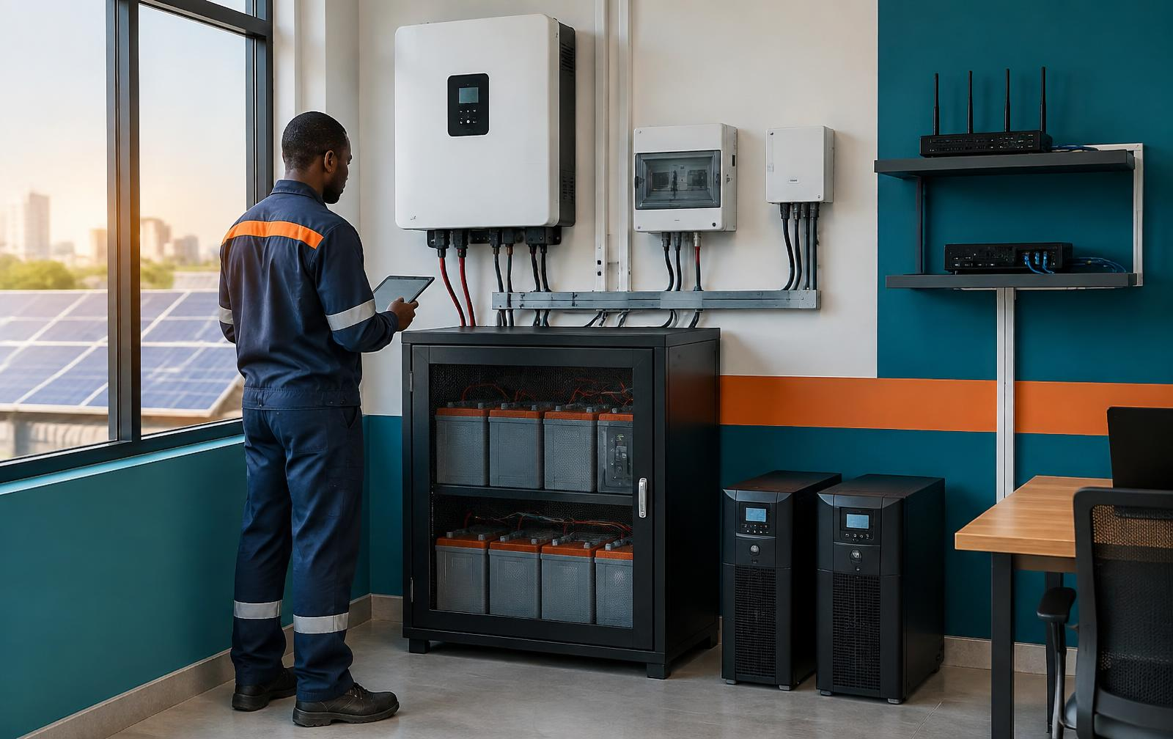
POWER & INTERNET BACKUP
Protect classes, laboratories and network equipment from interruptions.
PROBLEM
POSSIBLE IMPACT
TEKLOFTS PROVIDES
VALUE TO SQI
Computers, internet and labs need reliable power.
Interruptions can stop classes and affect equipment.
Suitable backup power and connectivity after assessment.
More reliable learning and better equipment protection.
Inverter
Battery storage
Solar panels
UPS
Network backup
Assessment & setup
Notes:
Do not recommend capacity or price before a site assessment. Teklofts would first check SQI’s loads, existing electrical systems, required backup time and internet setup, then recommend suitable equipment.

Slide 12
COMPLETE PRACTICAL LAB
One achievable room where students learn, build, test and show.
Computer area
Robotics table
Electronics bench
AI workstation
Network & cyber
3D printer
IoT demo
Storage & backup
LEARN → BUILD → TEST → SHOW
Notes:
This is a concept picture, not a final design. The room combines computer workstations, robotics and electronics benches, an AI workstation, networking practice, a 3D printer, IoT demonstrations, storage and backup power. Actual scope follows assessment.

Slide 13
HOW WE WORK
Start small: one location, one practical lab, 90 days.
01
02
03
04
05
06
07
08
TALK
CHECK
PLAN
SOURCE
DELIVER
INSTALL
TRAIN
SUPPORT
MEASURE BEFORE DECIDING WHETHER TO EXPAND
Students using equipment
Projects completed
Prototypes produced
Equipment use
Student feedback
Staff feedback
Notes:
Propose one location, one practical lab, selected equipment and selected students for 90 days. Sequence: talk, check, plan, source, deliver, install, train and support. Measure student use, projects, prototypes, equipment utilisation and feedback before expanding.

Slide 14
SQI PROVIDES
TEKLOFTS PROVIDES
TOGETHER
Students · teachers · curriculum · learning space · academic direction
Equipment · sourcing · delivery · setup · replacement support
Students learn · build · demonstrate · SQI showcases · Teklofts supports
SQI teaches technology.
Teklofts helps students build with it.
Start small. Prove it works. Improve it. Expand it.
Proposed next step: agree a joint site and equipment assessment.
info@teklofts.com · +234 906 576 9751 · teklofts.com
Notes:
Close with a clear division of responsibilities. SQI brings the academic environment; Teklofts brings equipment sourcing, delivery, setup and replacement support. Ask for one next step only: a joint site and equipment assessment for a small 90-day pilot.

Slide 15
FACT-FINDING
What does SQI need most right now?
Use this editable table during the discussion. Agree the next action before closing.
WHAT THEY NEED
PROBLEM THEY ARE FACING
PROPOSED RECOMMENDATION
PRIORITY / OWNER
NEXT ACTION / MEETING DATE
Type notes…
Type notes…
Type notes…
Type notes…
Type notes…
Type notes…
Type notes…
Type notes…
Type notes…
Type notes…
Type notes…
Type notes…
Type notes…
Type notes…
Type notes…
Type notes…
Type notes…
Type notes…
Type notes…
Type notes…
Prepared by: ____________________ SQI contact: ____________________ Date: ____________________
Notes:
Use this slide as the meeting worksheet. Capture each need, the current problem, an assessment-led recommendation, the responsible person or priority, and the agreed next action or meeting date. Do not promise products, quantities, prices or dates before assessment.

